Slide 1
The DevOps Infinity Loop: The SocialDev Journey
Notes:
Introduce the team. State clearly that this isn't just a coding project; it's an infrastructure project

Slide 2
The Mission (The "Why")
Problem: YouTube is for entertainment, not studying. Distractions are high, tools are low.
Solution: SocialDev fetch playlists, take timestamped notes, track progress.
Tech Highlight: Next.js Frontend, Node.js Backend.
Notes:
We built an app to turn YouTube into a classroom. But to build it reliable, we needed DevOps

Slide 3
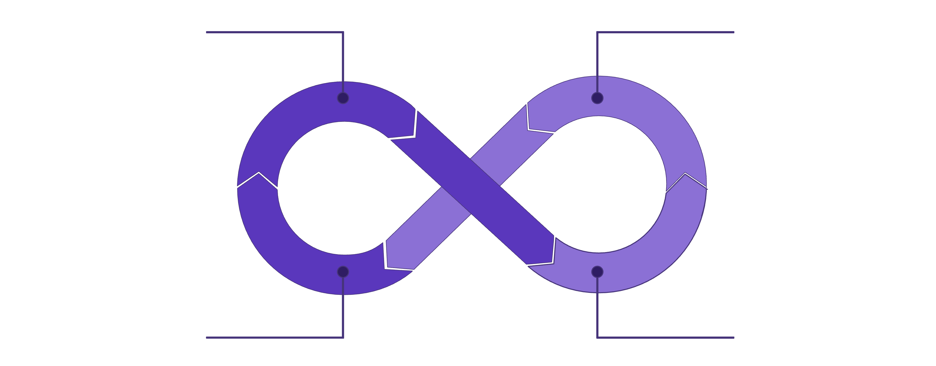
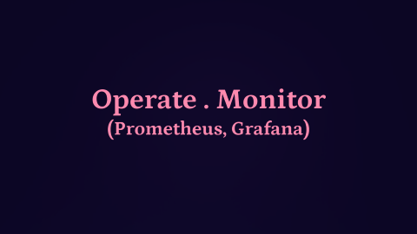
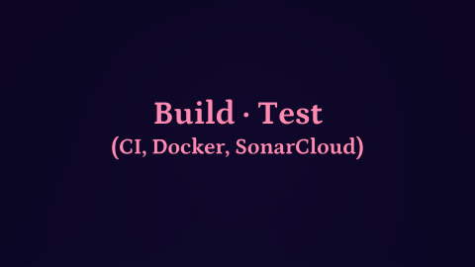
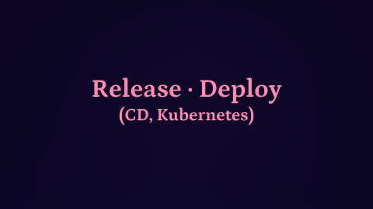
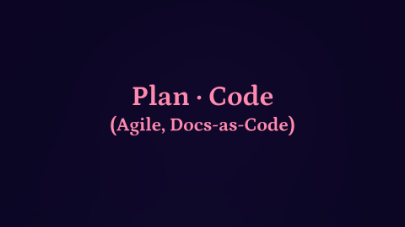
The DevOps Infinity Loop: A Continuous Journey
DevOps is a philosophy that unites development and operations teams, fostering a culture of collaboration and shared responsibility. This infinity loop illustrates the continuous integration and continuous delivery (CI/CD) pipeline, ensuring faster, more reliable software releases.
DevOps Phases

Slide 4
Plan · Code
(Agile, Docs-as-Code)

Slide 5

Plan: Setting the Foundation
The Plan phase is the cornerstone of any successful DevOps initiative. It involves meticulously defining project goals, gathering comprehensive requirements, and establishing realistic timelines.
Docs-as-Code: Planning artifacts live in the repo (/docs).
Examples: frontend/docs/README.md (Feature specs), KUBERNETES.md (Infra specs).

Slide 6

Code: Collaborative Development
The Code phase is where ideas transform into tangible software. It emphasizes collaboration, quality, and efficiency among development teams.
Developers write, review, and commit code frequently to maintain a fluid development cycle.
Strong emphasis on version control systems like Git to manage changes and facilitate concurrent work.
Rigorous code quality checks and peer reviews ensure high standards and reduce technical debt.

Slide 7
The Architecture
Frontend: Next.js 15, TypeScript, Tailwind.
Backend: Node.js Express.
The Secret Sauce: n8n Workflow Automation.
Decoupled YouTube API logic.
Enhanced security (API keys hidden in n8n).

Slide 8
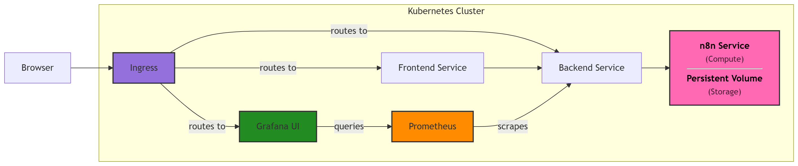
The Architecture

Slide 12
Build · Test
(CI, Docker, SonarCloud)

Slide 13
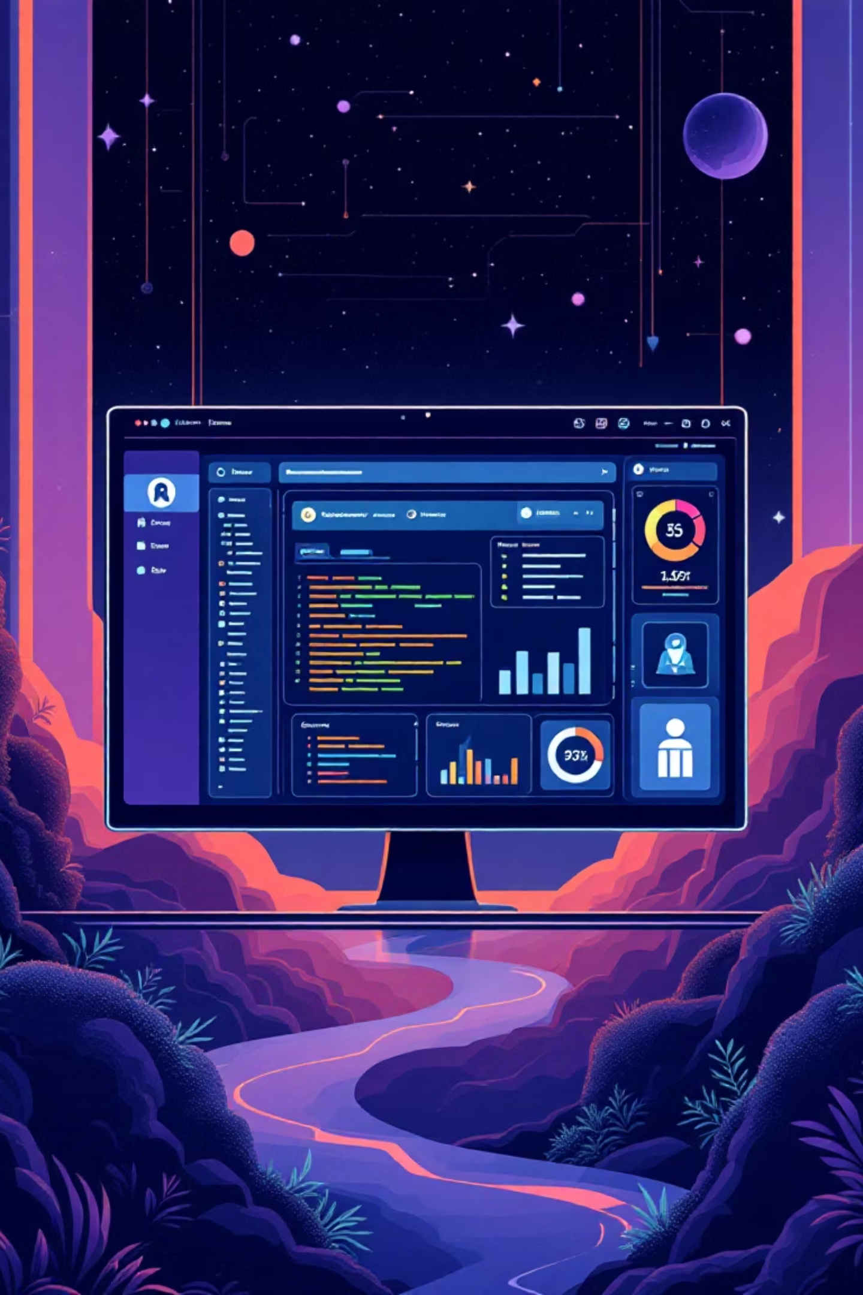
Build: Automated Compilation & Packaging
The Build phase is critical for transforming source code into executable software. Automation is paramount to ensure consistency and speed.
Continuous Integration (CI) servers automatically compile code, run static analysis, and perform basic checks with every commit.
Build artefacts, such as executables and libraries, are systematically packaged and prepared for subsequent testing and deployment stages.
Tools like GitHub Actions automate these build pipelines, ensuring a reliable and repeatable process.

Slide 14
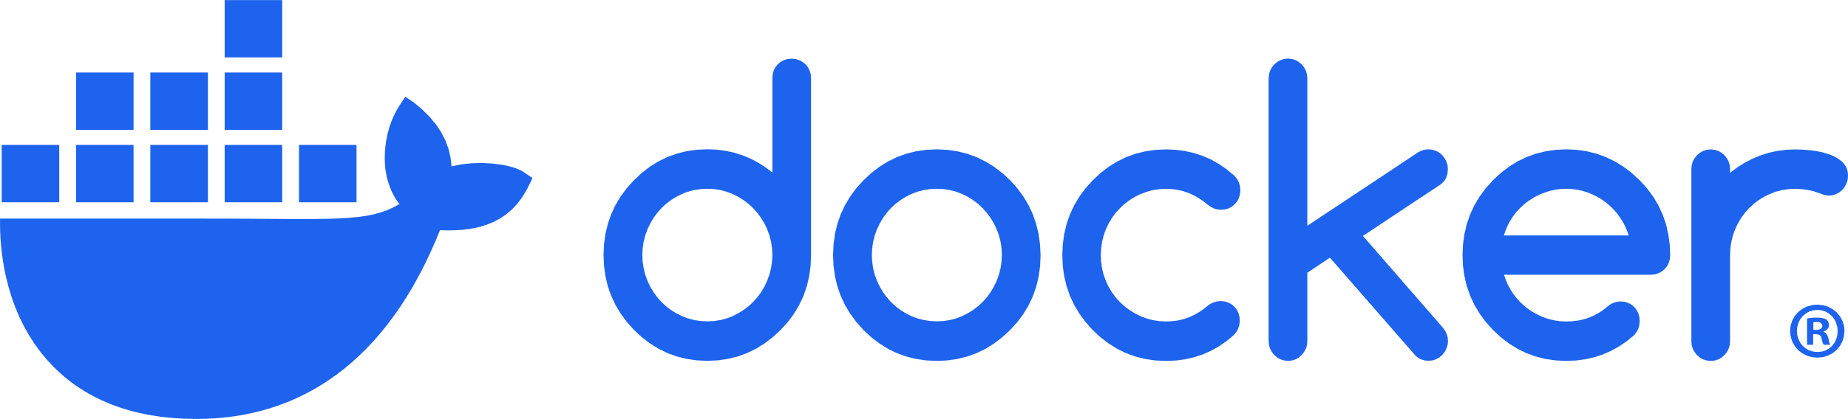

Slide 15
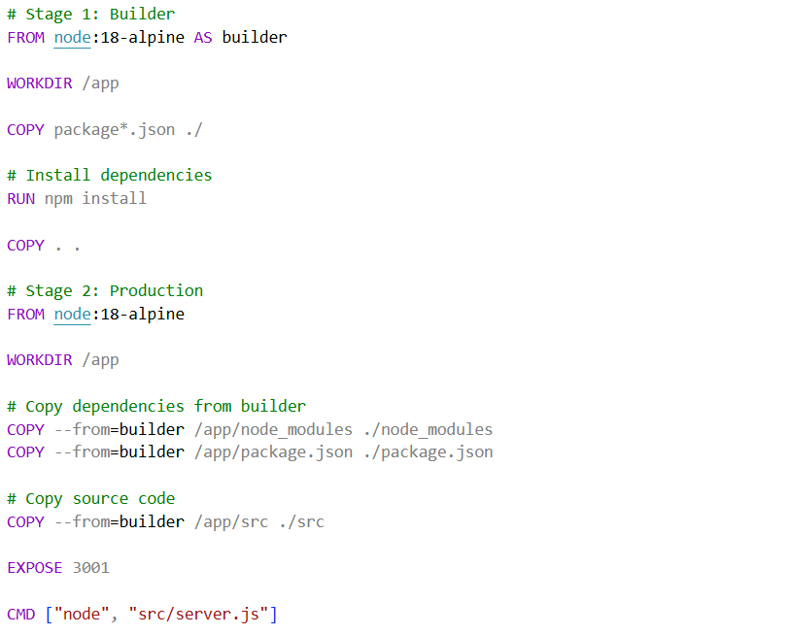
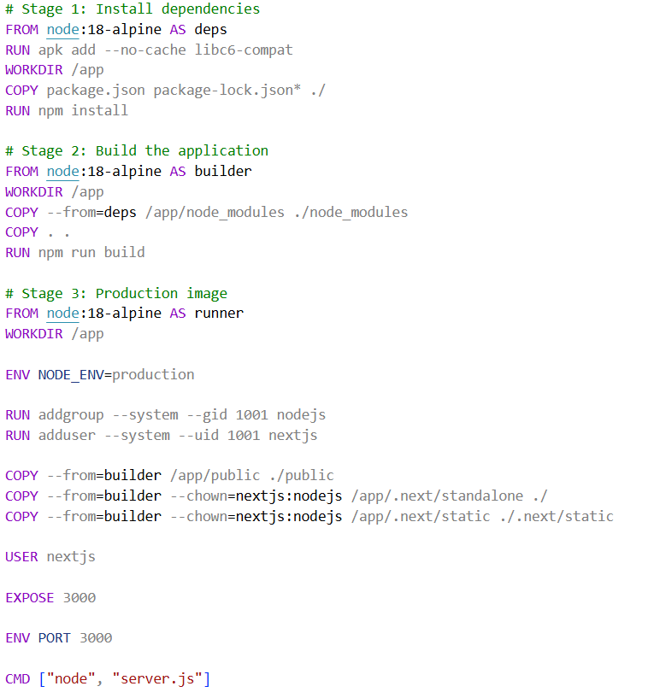

Slide 16
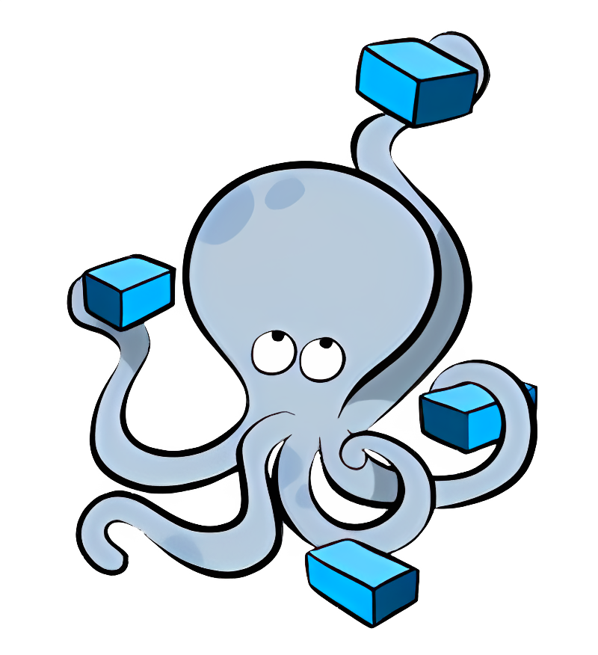
Docker Compose
Notes:
Docker compose for dev and for production versions

Slide 17
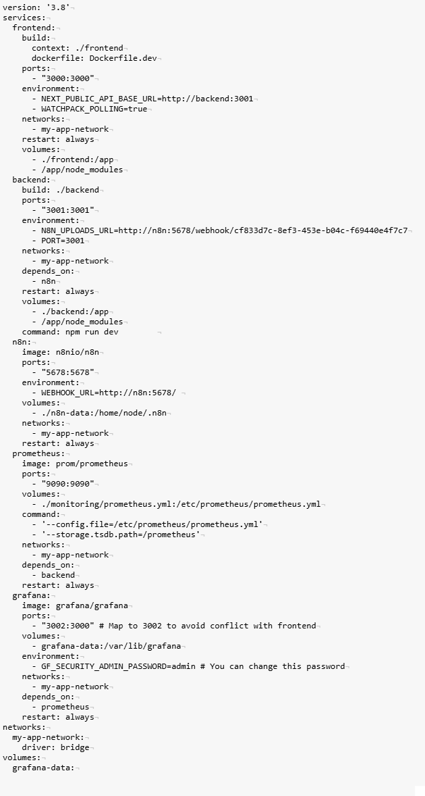

Slide 20
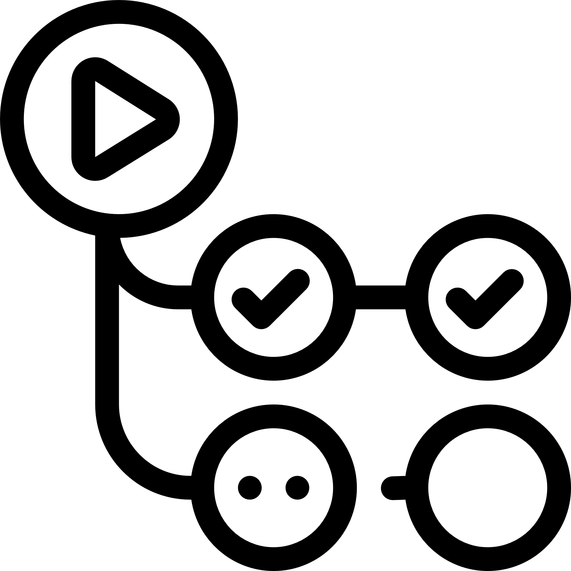
GitHub Actions
Notes:
Content:
Trigger: Push to main or Pull Request.
Stage 1: Validation: Linting (ESLint), Static Analysis, Unit Tests (Jest).
Stage 2: Build: Multi-stage Docker builds (optimized image size).
Speaker Points: "We don't rely on hope. Every commit triggers a pipeline. If the tests fail, the merge is blocked."

Slide 21
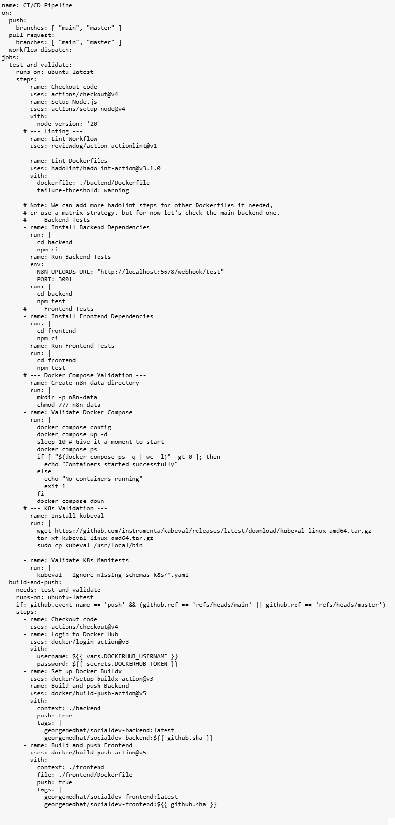
Notes:
Title: The GitHub Actions Pipeline
Visual: Screenshot or Diagram of the ci-cd.yml workflow.
Content:
Trigger: Push to main or Pull Request.
Stage 1: Validation: Linting (ESLint), Static Analysis, Unit Tests (Jest).
Stage 2: Build: Multi-stage Docker builds (optimized image size).
Speaker Points: "We don't rely on hope. Every commit triggers a pipeline. If the tests fail, the merge is blocked."
Slide 8: "Shift-Left" Quality Gates
Title: Ensuring Quality Early
Content:
SonarCloud: Static Code Analysis (Bugs, Vulnerabilities).
Hadolint: Dockerfile linting (Best practices).
Kubeval: Validating Kubernetes manifests before deployment.
Speaker Points: "We practice 'Shift-Left.' We validate our Kubernetes configs and Dockerfiles during the build, not when we try to deploy."

Slide 22
Notes:
Title: The GitHub Actions Pipeline
Visual: Screenshot or Diagram of the ci-cd.yml workflow.
Content:
Trigger: Push to main or Pull Request.
Stage 1: Validation: Linting (ESLint), Static Analysis, Unit Tests (Jest).
Stage 2: Build: Multi-stage Docker builds (optimized image size).
Speaker Points: "We don't rely on hope. Every commit triggers a pipeline. If the tests fail, the merge is blocked."
Slide 8: "Shift-Left" Quality Gates
Title: Ensuring Quality Early
Content:
SonarCloud: Static Code Analysis (Bugs, Vulnerabilities).
Hadolint: Dockerfile linting (Best practices).
Kubeval: Validating Kubernetes manifests before deployment.
Speaker Points: "We practice 'Shift-Left.' We validate our Kubernetes configs and Dockerfiles during the build, not when we try to deploy."

Slide 23

Test: Quality Assurance & Validation
The Test phase focuses on comprehensive quality assurance and validation, ensuring software reliability and performance.
Automated unit, integration, and acceptance tests are executed rigorously on every build to identify defects early.
"Shift-left testing" is a key practice, moving testing activities earlier in the development lifecycle to catch issues when they are less expensive to fix.

Slide 24


Slide 25
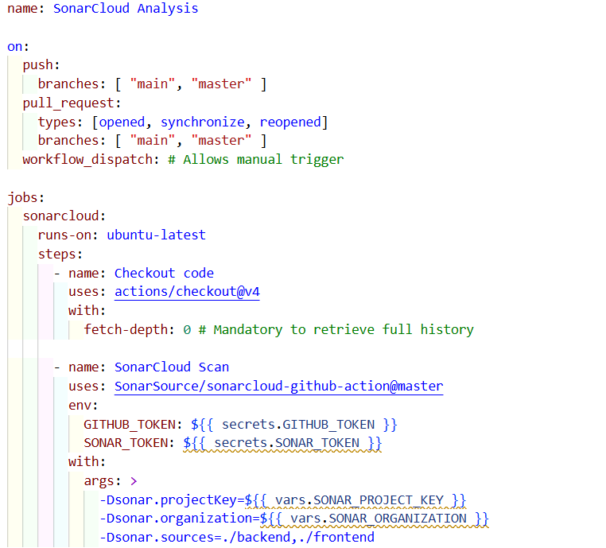

Slide 26
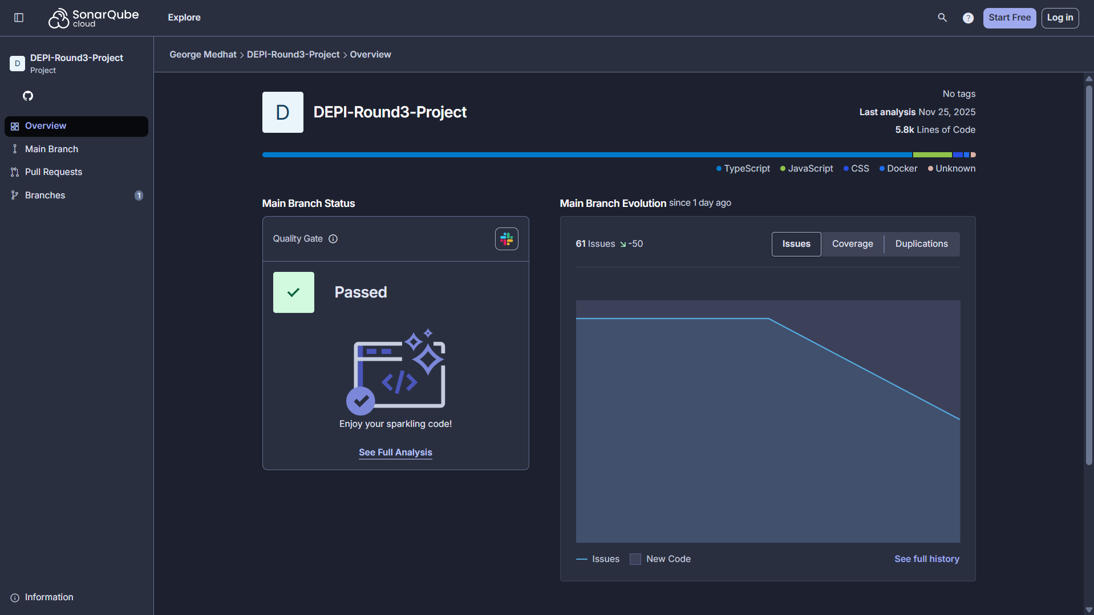


Slide 27
Release · Deploy
(CD, Kubernetes)

Slide 28

Release: Preparing for Production
The Release phase orchestrates the final preparations for introducing new software versions into the production environment.
This involves final validation checks, precise version tagging, and thorough creation of release notes to document changes and features.
Effective release management ensures a seamless and efficient handoff to deployment teams, minimising potential friction and errors.

Slide 29

Deploy: Automated Delivery & Rollout
The Deploy phase is where validated software is delivered to users, with automation playing a crucial role in speed and safety.
Continuous Delivery (CD) pipelines automate the deployment process to staging and production environments, ensuring rapid and reliable delivery.

Slide 30
GitHub Actions

Slide 31
Notes:
Registry: Docker Hub.
Tagging Strategy:
:latest (for convenience).
:<git-sha> (e.g., :a1b2c3d) for immutability.
Speaker Points: "We can trace any running container back to the exact line of code that created it using the Git SHA tag."

Slide 32
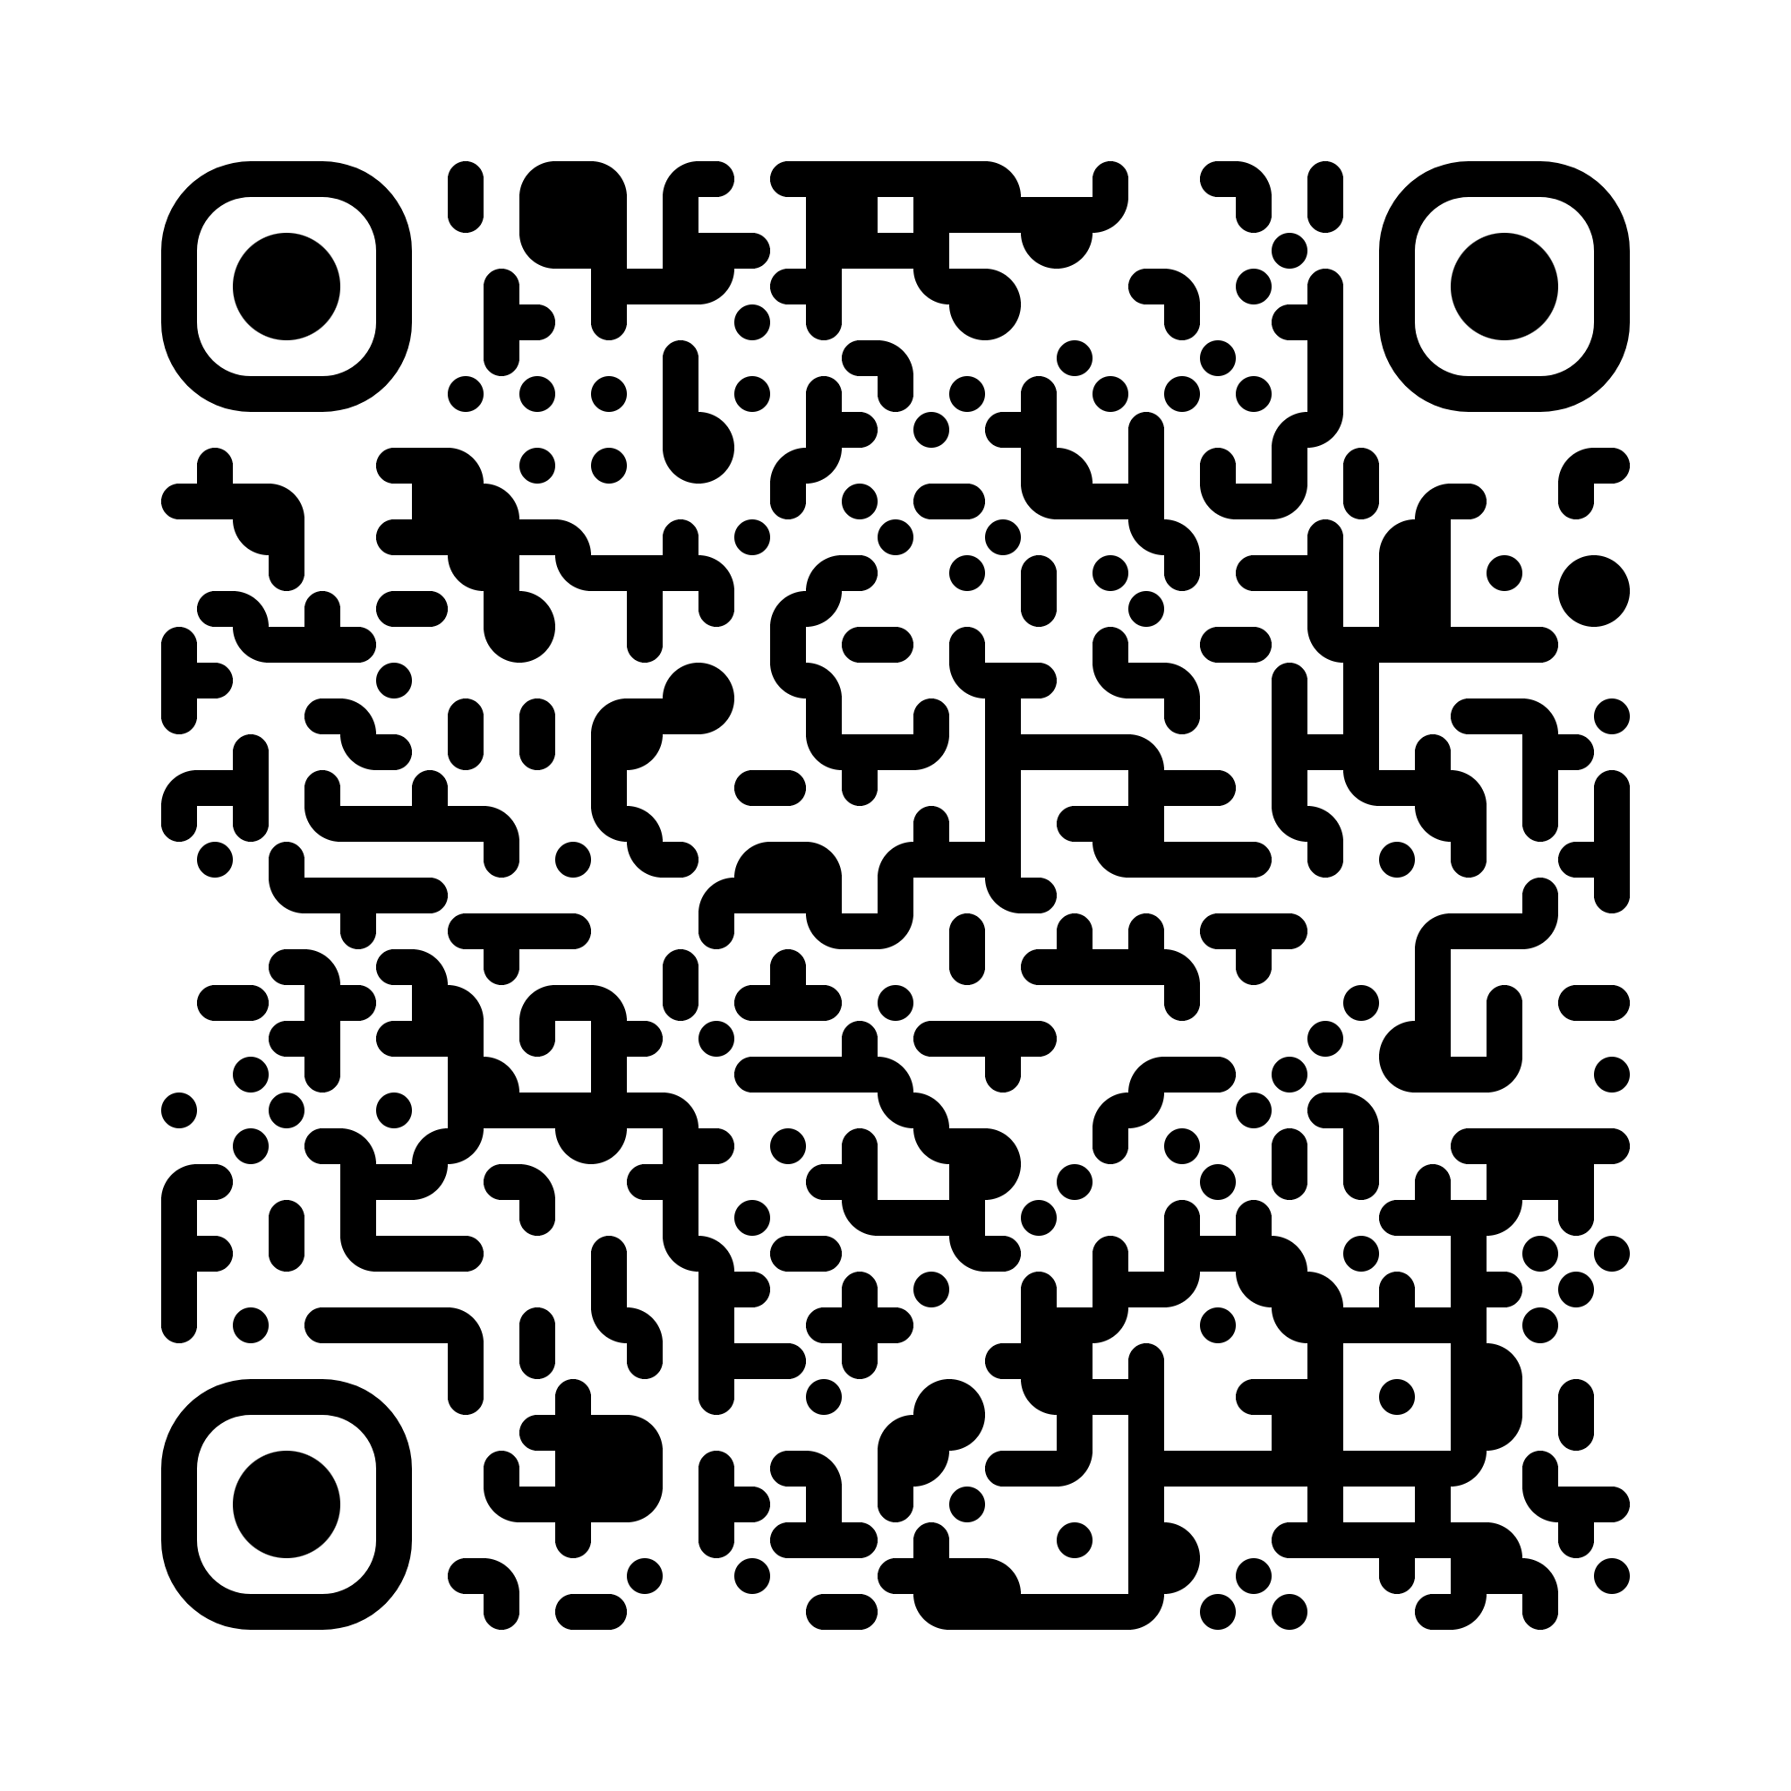
Notes:
Registry: Docker Hub.
Tagging Strategy:
:latest (for convenience).
:<git-sha> (e.g., :a1b2c3d) for immutability.
Speaker Points: "We can trace any running container back to the exact line of code that created it using the Git SHA tag."

Slide 33
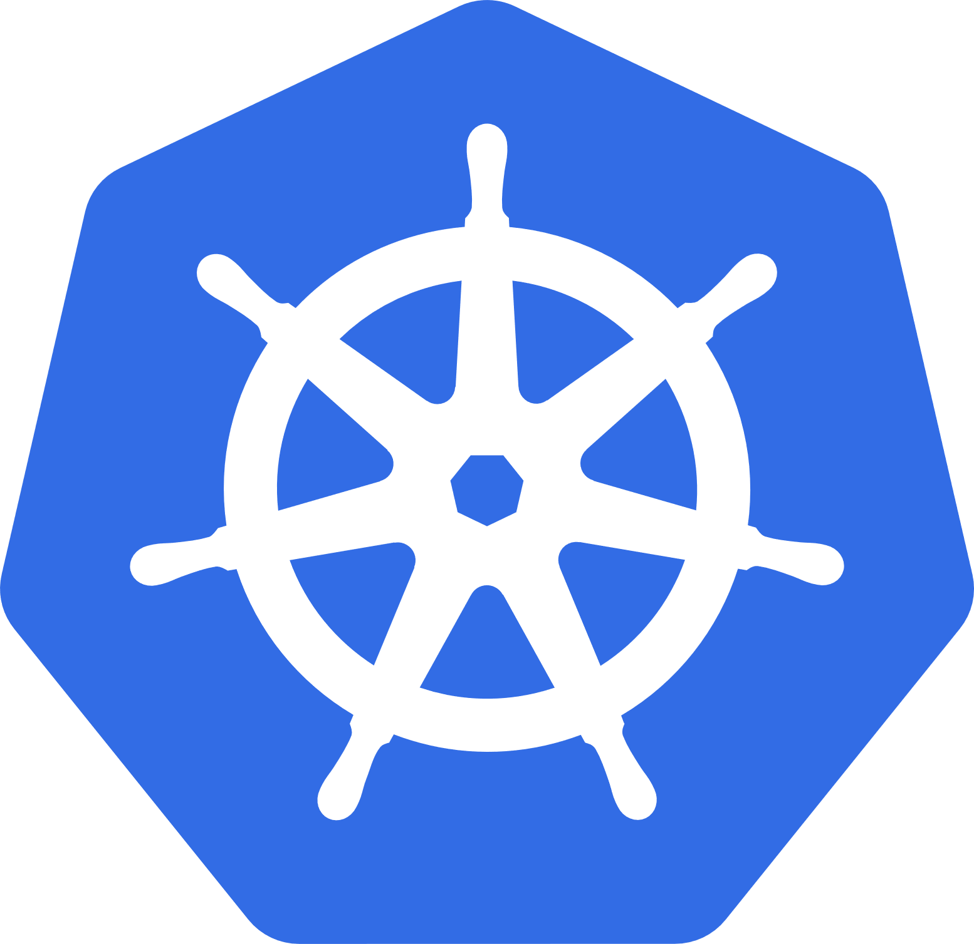

Notes:
Declarative: Defined in /k8s directory (Deployments, Services, Ingress).
Templating: Using simple templates for Environment Variables (e.g., Domain names).
Ingress: Managing routing between Frontend and API.
Speaker Points: "Our infrastructure is version controlled just like our app code."
Title: Production on Kubernetes
Content:
Strategy: Rolling Updates (Zero Downtime).
Resilience: Self-healing pods (Automatic restarts).
Scalability: Frontend and Backend replicas > 1.
Speaker Points: "We deploy to Kubernetes to ensure that if a pod crashes, the user never notices. The system heals itself."

Slide 34
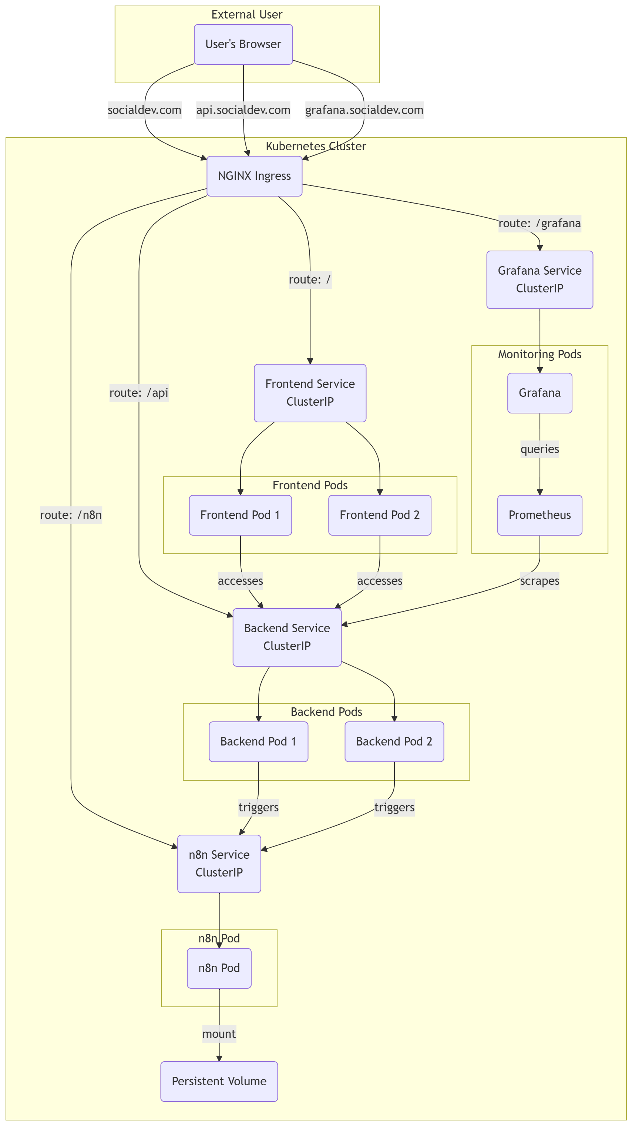

Slide 37
Operate . Monitor
(Prometheus, Grafana)
Notes:
Content:
Prometheus: Scrapes metrics via ServiceMonitor.
Grafana: Visualizes health (CPU, Memory, Request Rate).
ConfigMaps: Dashboards are stored as code (grafana-dashboard-cm.yaml).
Speaker Points: "We don't configure dashboards manually. Even our monitoring dashboards are defined as code and injected into the cluster."

Slide 38

Operate & Monitor: Ensuring Stability & Feedback
The Operate & Monitor phases are intertwined, focusing on maintaining system health, performance, and continuous improvement.
Real-time monitoring of application health and underlying infrastructure is essential to detect and address issues proactively.
Robust incident management protocols and established feedback loops are crucial for driving continuous improvement and learning from operational experiences.
Tools like Prometheus, Grafana, and the ELK stack (Elasticsearch, Logstash, Kibana) provide comprehensive observability and alert capabilities.
DevOps is a continuous, collaborative journey — the infinity loop never ends, always striving for better, faster, and more reliable software delivery.
Notes:
Content:
Prometheus: Scrapes metrics via ServiceMonitor.
Grafana: Visualizes health (CPU, Memory, Request Rate).
ConfigMaps: Dashboards are stored as code (grafana-dashboard-cm.yaml).
Speaker Points: "We don't configure dashboards manually. Even our monitoring dashboards are defined as code and injected into the cluster."

Slide 39


Prometheus & Grafana
Notes:
Content:
Prometheus: Scrapes metrics via ServiceMonitor.
Grafana: Visualizes health (CPU, Memory, Request Rate).
ConfigMaps: Dashboards are stored as code (grafana-dashboard-cm.yaml).
Speaker Points: "We don't configure dashboards manually. Even our monitoring dashboards are defined as code and injected into the cluster."

Slide 40
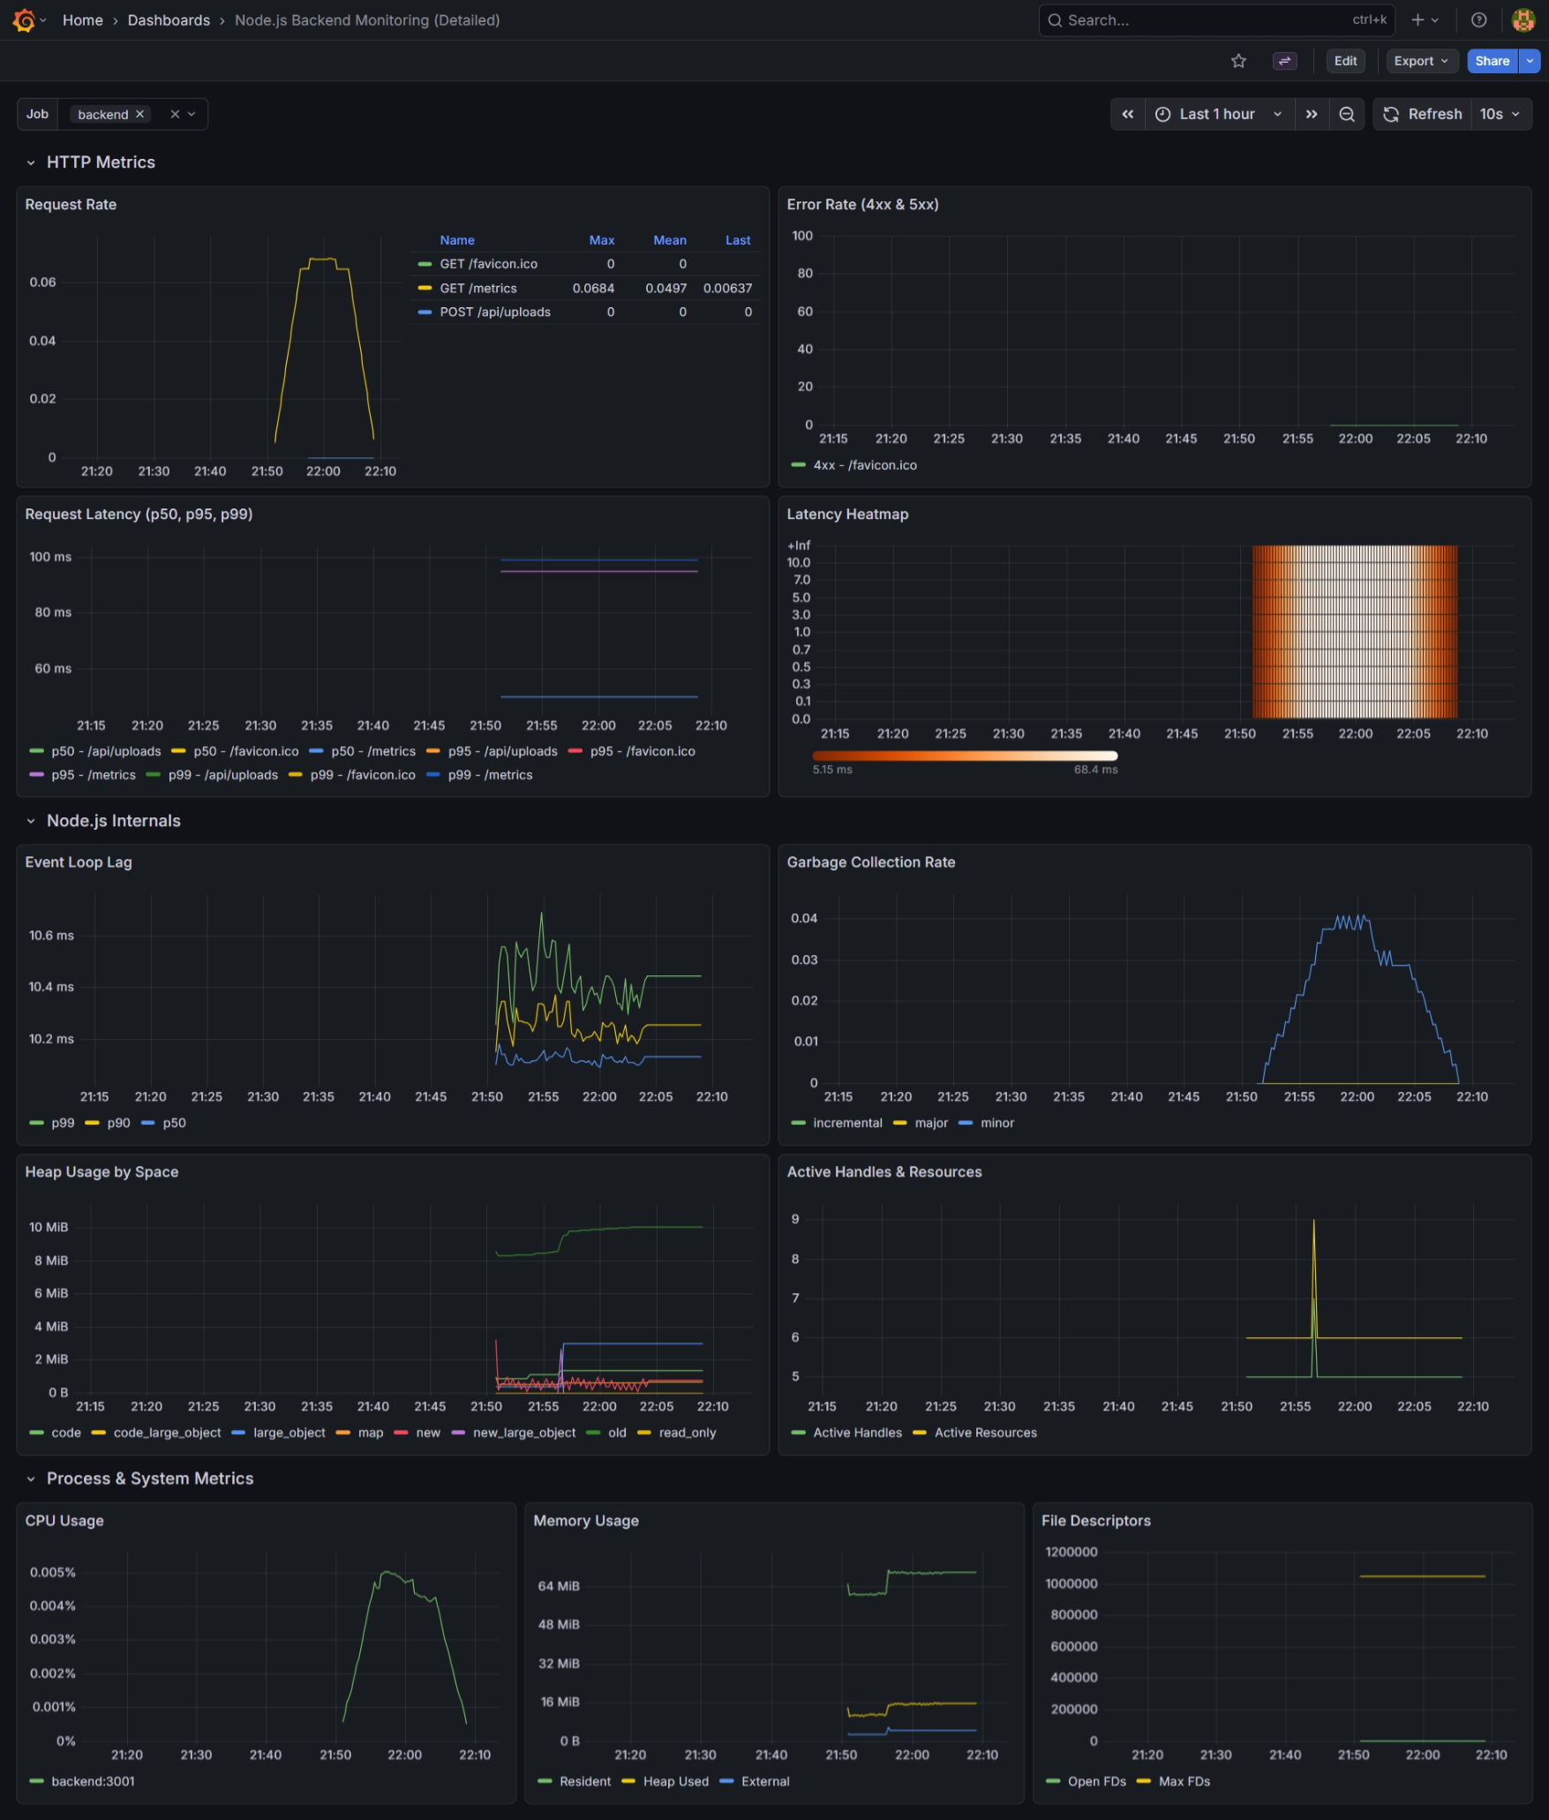

Slide 42
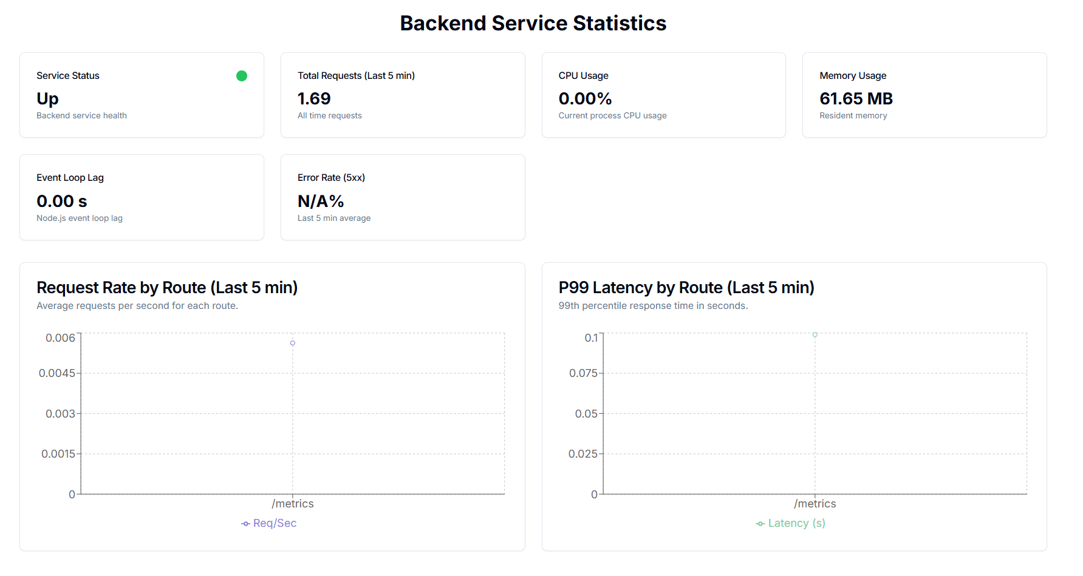

Slide 43
Thank you

